Slide 1

Alumniti Illuminating Careers. Insightful Journeys. Informed Decisions.
DASS Course Project – Team 30
Notes:
Good morning/afternoon. Thank you, Professor Raghu Reddy, TA Muskan Raina, and our client Aditya Jain Pansari for this opportunity. Choosing a college or career often feels like navigating a maze blindfolded. Today, we introduce AlumNiti – designed to illuminate the path forward with insights from those who've already walked it.

Slide 2
Section 1 The Maze

Slide 3
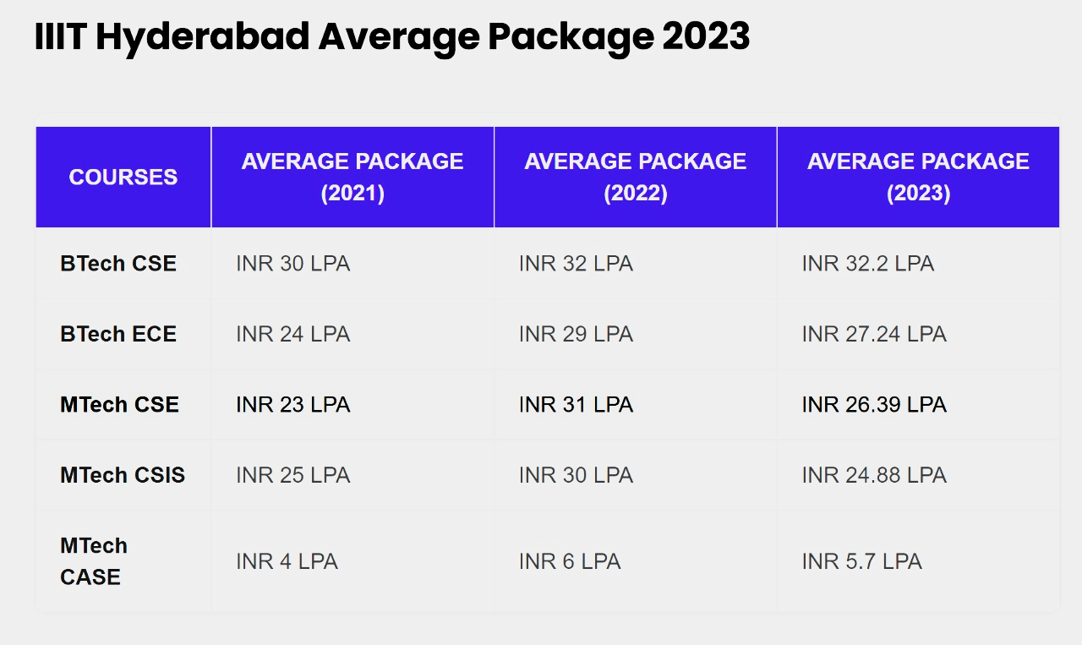
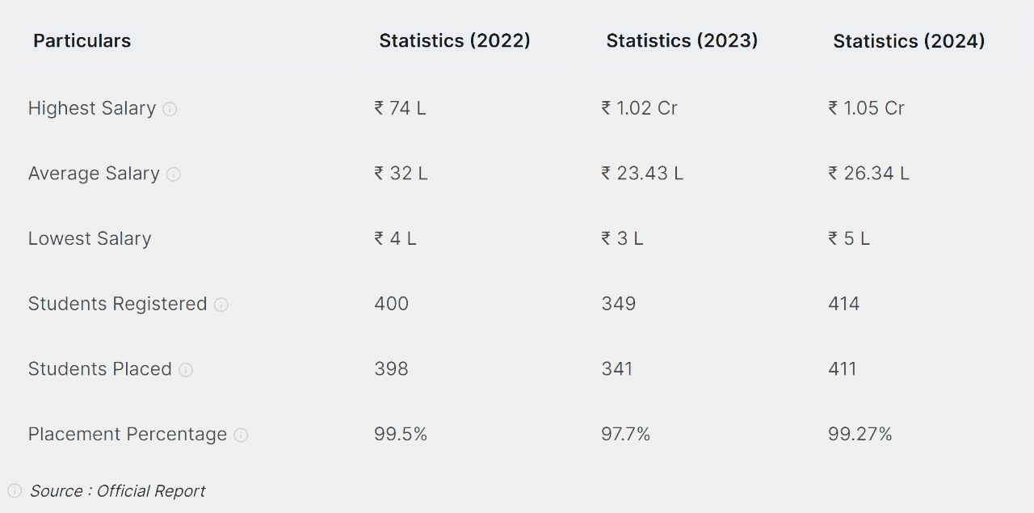
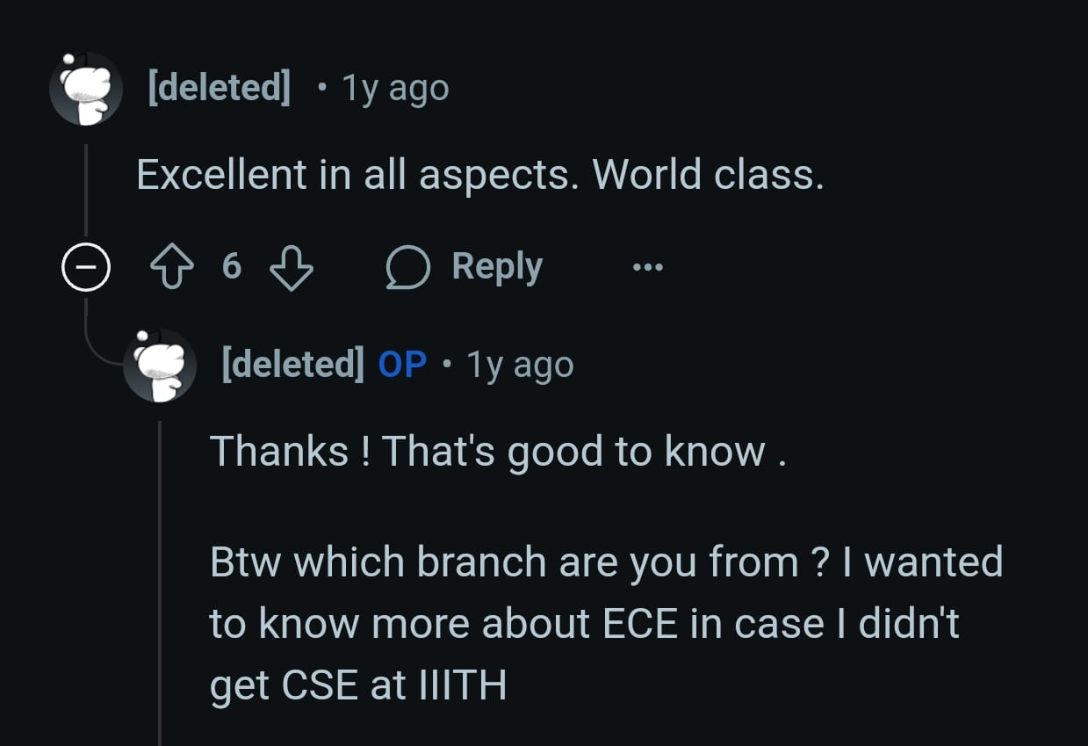
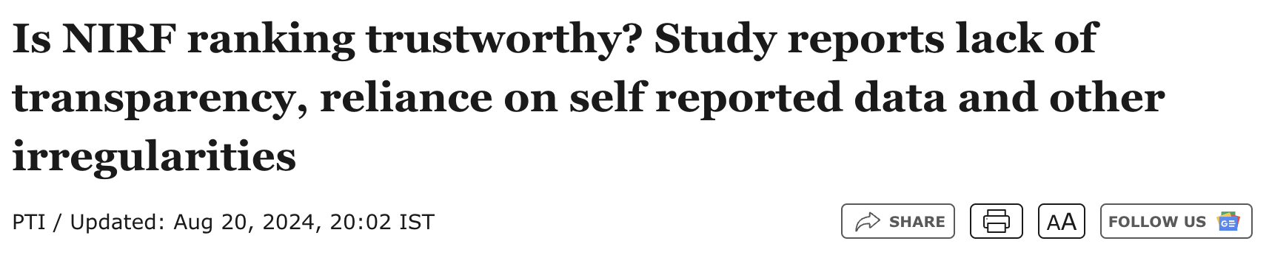
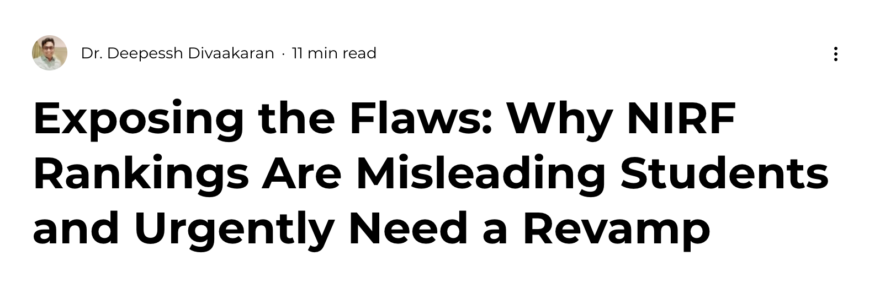

The Truth is Buried: Scattered, Conflicting, Unreliable Data
Problem 1: Vital stats (Facilities, Branches, Placements, Fees, Cutoffs) fragmented across unreliable sources.
+
Problem 2: Accuracy is inconsistent – leading to misinformed decisions.
=
Result: Hours wasted searching; critical choices based on flawed information.
[Inconsistent statistics across websites]
[someone claiming IIITH to be perfect]]
[NIRF ranks don’t fit all—our platform lets users filter by what truly matters, backed by real alumni voices]
Notes:
The first barrier? Data chaos. Critical decision-making information is scattered and often conflicting. [Point to visual] Different sources show different stats for the same program! This isn't just confusing; it leads to decisions based on bad data – a major source of later regret for many students.

Slide 4
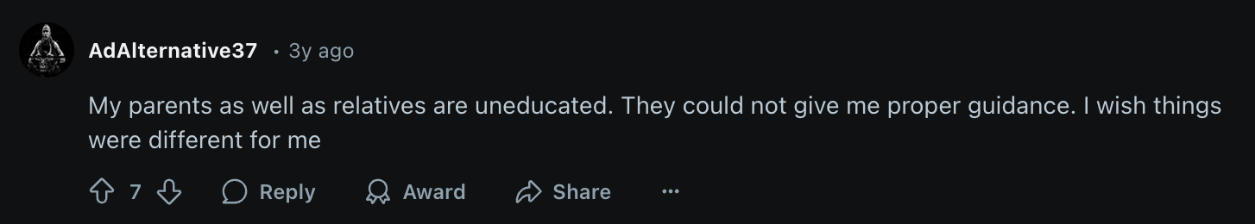
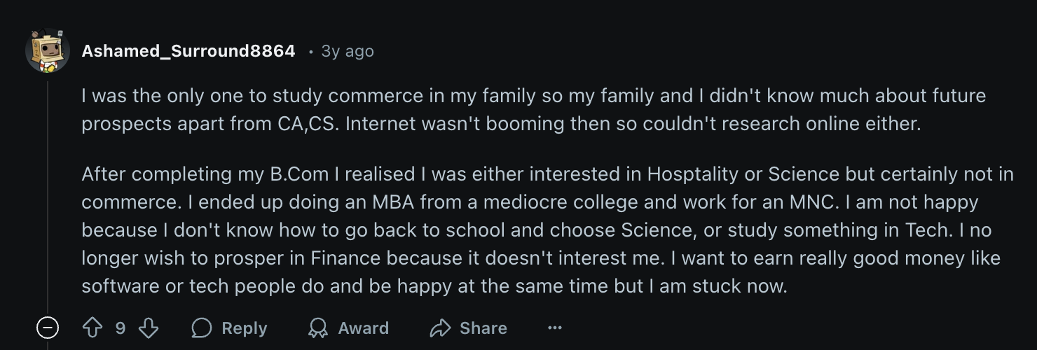
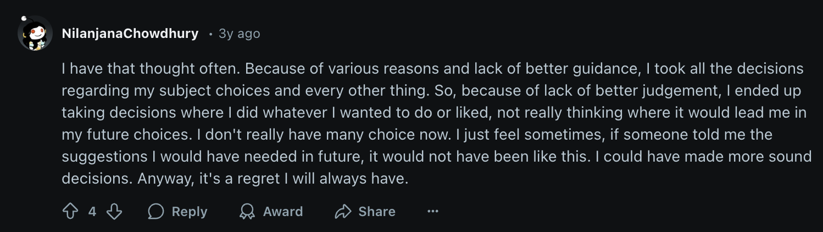
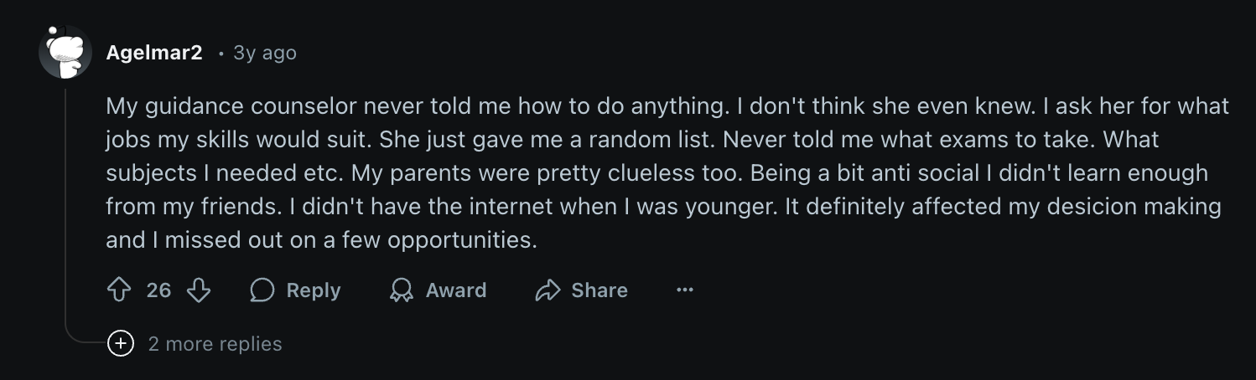
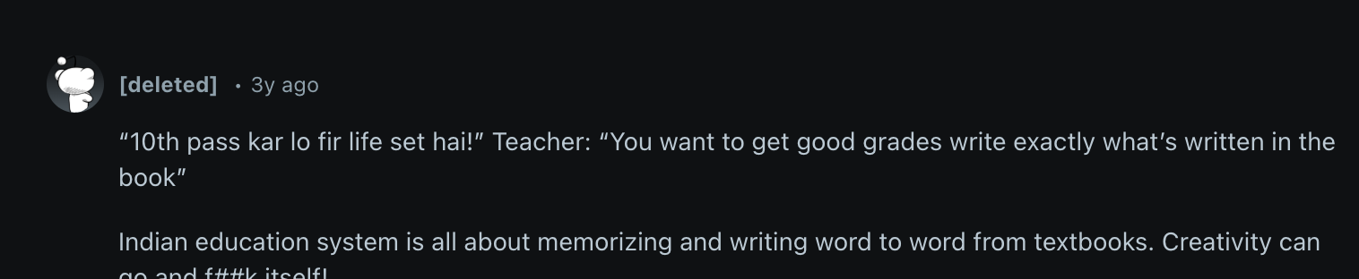
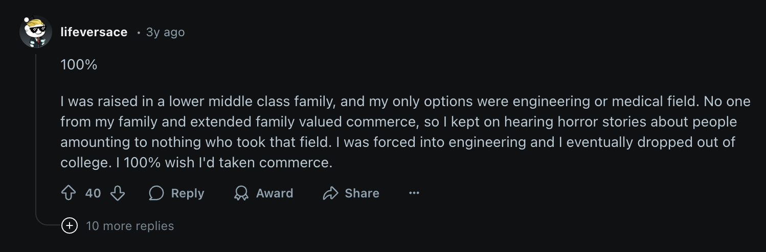
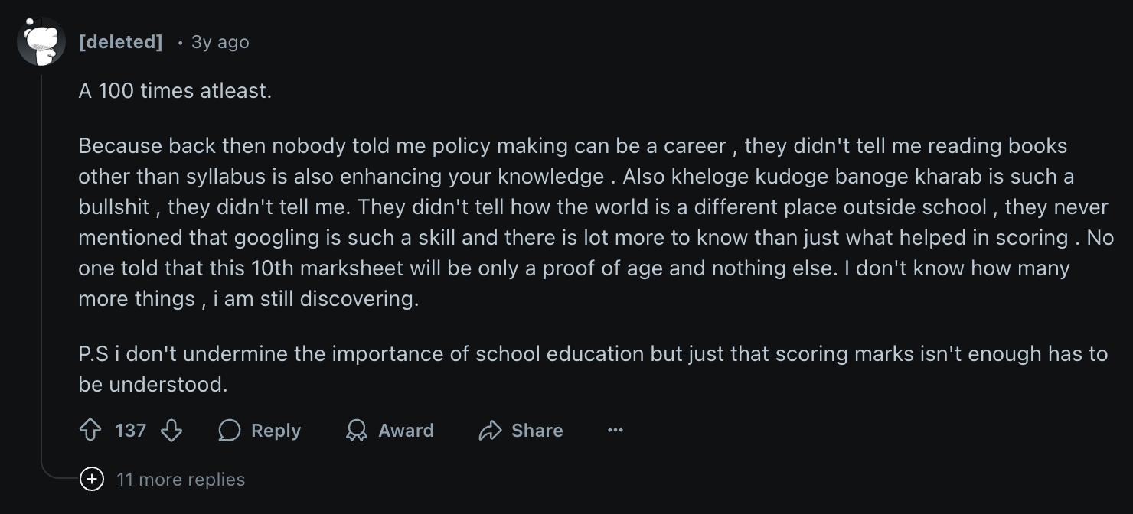
Generic Guidance vs. Relevant Reality = Student Regret
Problem 1: Lack of accessible mentorship providing current, specific insights.
+
Problem 2: Difficulty connecting with recent graduates or current students for authentic, unfiltered perspectives.
=
Result: We constantly see posts online:
'I wish I knew this before choosing!’
This lack of a structured, reliable source of truth fuels anxiety and wrong choices.
Notes:
The second barrier is the advice dilemma. Standard guidance often lacks relevance to specific, current situations. What's desperately needed is accessible mentorship from peers – recent grads who can share unfiltered, authentic experiences. We see the consequences daily online – students wishing they had better guidance. There's a clear gap for a reliable source offering Niti from those who know.

Slide 5

Section 2 The Compass

Slide 6
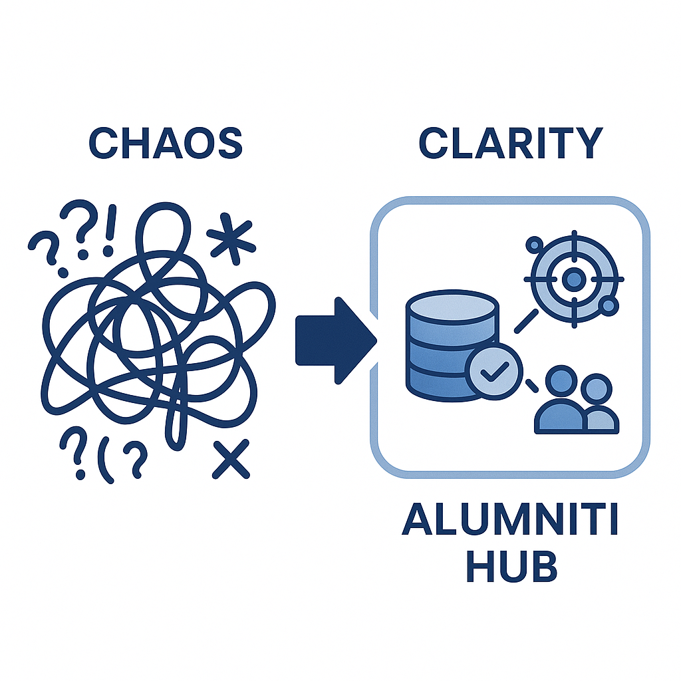
Alumniti: One Platform for Clarity, Connection & Confidence
Mission: Empowering informed career choices through authentic experiences & structured guidance.
We Verify: We consolidate and validate crucial data.
We Connect: We bridge the gap to relevant, verified student & alumni mentors.
We Deliver: Authentic content & trustworthy AI insights for choices based on capability and interest.
Notes:
AlumNiti is the answer. Our mission is to provide immediate access to structured guidance, enabling choices based not just on scores, but on true capability and interest. We achieve this by verifying data, connecting users with relevant mentors, and delivering authentic content and AI insights – all in one platform.

Slide 7





Our Features Ecosystem: Designed for Impact
Verified Data Hub
Your reliable truth source.
Relevant Expert Network
Connect with relevant experience.
Authentic Content Stream
Learn from real journeys.
Houses Video Insights (unfiltered journeys - podcasts) and Verified Blogs (ground-truth perspectives).
Powers our College Explorer, letting you filter colleges by distance, placements, etc.
Cleaned, validated data.
Enables Connect with Alumni for sessions/mentorship, and the Become an Expert feature for verified alumni sharing.
AI & Insights
Personalized guidance.
Includes our AI Career Assistant* (reliable answers from our data) and Psychometric Tests.
*beta feature: needs more fine-tuning to yield 100% reliable results
Governed by Admin Control
(ensures platform integrity)
Notes:
We deliver this through an ecosystem of features: Our Verified Data Hub powers the College Explorer, providing reliable, filterable information. The Relevant Expert Network facilitates both Connecting with Alumni and allows professionals to Become Experts. The Authentic Content Stream delivers trustworthy Video Insights and Verified Blogs. Our AI & Insights pillar includes Psychometric Tests and the AI Assistant. Crucially, this AI (although a beta feature) queries our internal, verified database, making its answers highly reliable within that context, even as the tech evolves. This ecosystem is governed by Admin Control for quality.

Slide 8

Section 3 The Engine

Slide 9
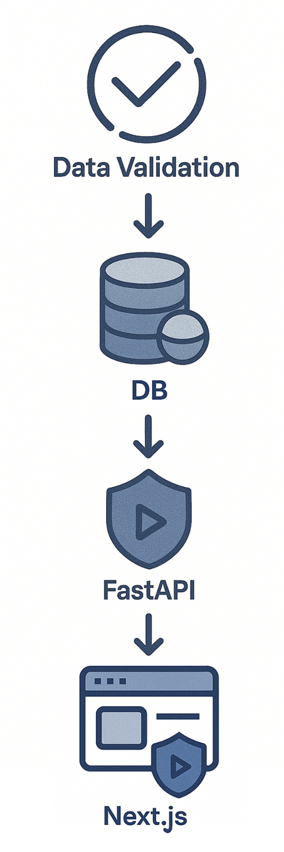
Our Engine: Secure, Scalable, Performant
Core Principles:
Data Integrity, User Security, System Performance with Scalability.
Key Tech & Rationale:
FastAPI (Python): High-performance backend for data validation pipeline & async query handling. AI-ready.
Next.JS (React): Fast, modern frontend for seamless UX.
MongoDB: Flexible & scalable for diverse, growing data.
Behind the Scenes:
Secure Authentication mechanisms for login/signup.
Dedicated Expert & Admin Dashboards for management.
Privacy & Piracy Controls (e.g., video overlays).
Robust Data Validation Pipelines ensuring data trustworthiness.
Notes:
Delivering this reliably demands a solid technical foundation. Our core design prioritizes data integrity and performance. We use FastAPI for its asynchronous power, crucial for our data validation pipelines and handling database load. Next.JS ensures a fast UI. MongoDB provides flexibility and scale. 'Behind the scenes,' we implement secure authentication, dedicated Expert and Admin Dashboards, and privacy controls like video overlays. Our data validation pipeline is central. This technical focus ensures AlumNiti is trustworthy, secure, and performant.

Slide 10
Section 4 The Journey

Slide 11
Demo: Your Alumniti Experience
https://drive.google.com/file/d/1jvjYOrLQETXmCiGufSWT2WS1P_PGtmun/view?usp=sharing
Notes:
Let's see AlumNiti in action.
First, like any responsible user, I navigate to the login page and get started. Since no one uses their hands anymore, I naturally launch our chatbot and ask about this college I have heard a lot about. The bot queries our database and returns results in a descriptive format. Reading it, I realize that hey, I have myself posted a blog on it and there’s also a video about UGEE. Also apparently I am a UG2 student here? Very curious, I use the unified search bar to go to the college’s page, but reading the description I realize that this college is too hectic for my taste. So, then I navigate to the college explorer page and search for a college in a better state, like Delhi, which is actually a Union Territory. Opening up IIT Delhi’s page, I glance at the facilities panel and I immediately see the WiFi card. I am convinced. Now, I go to one of the branches to check the cutoffs and placements. Peeking at the cutoffs, I decide that I am too good for this college and so I go to the blogs section, where I open up this blog on BITS Patna. Surprisingly, I had authored this blog too and so, I can edit it or delete it. I now decide to check out the UGEE video the bot had told me about. But right about as I play it, I realize that why not connect with the expert who uploaded this video directly? So I open up their page, and because I just so happen to be a billionaire on the platform, I use the meeting functionality to reserve a meet with the expert in their next available slot. The meeting details and google meet link are automatically shared with my email account, and the same becomes visible on my dashboard. Now, since I have no notifications, I decide to give one of the career assessment tests. However, pretty soon I get bored and so instead I use the college-branch predictor, inputting my score and fetching results. Given that I am getting into some pretty good colleges, I decide to navigate to my expert dashboard since I am an expert, and publish a grateful, kind and supportive post. Using our platform’s content enhancer, I get the content in a pretty nice format and post it. Then, like any self-respecting individual, I like my own post and logging out, proceed with the rest of my day.

Slide 12
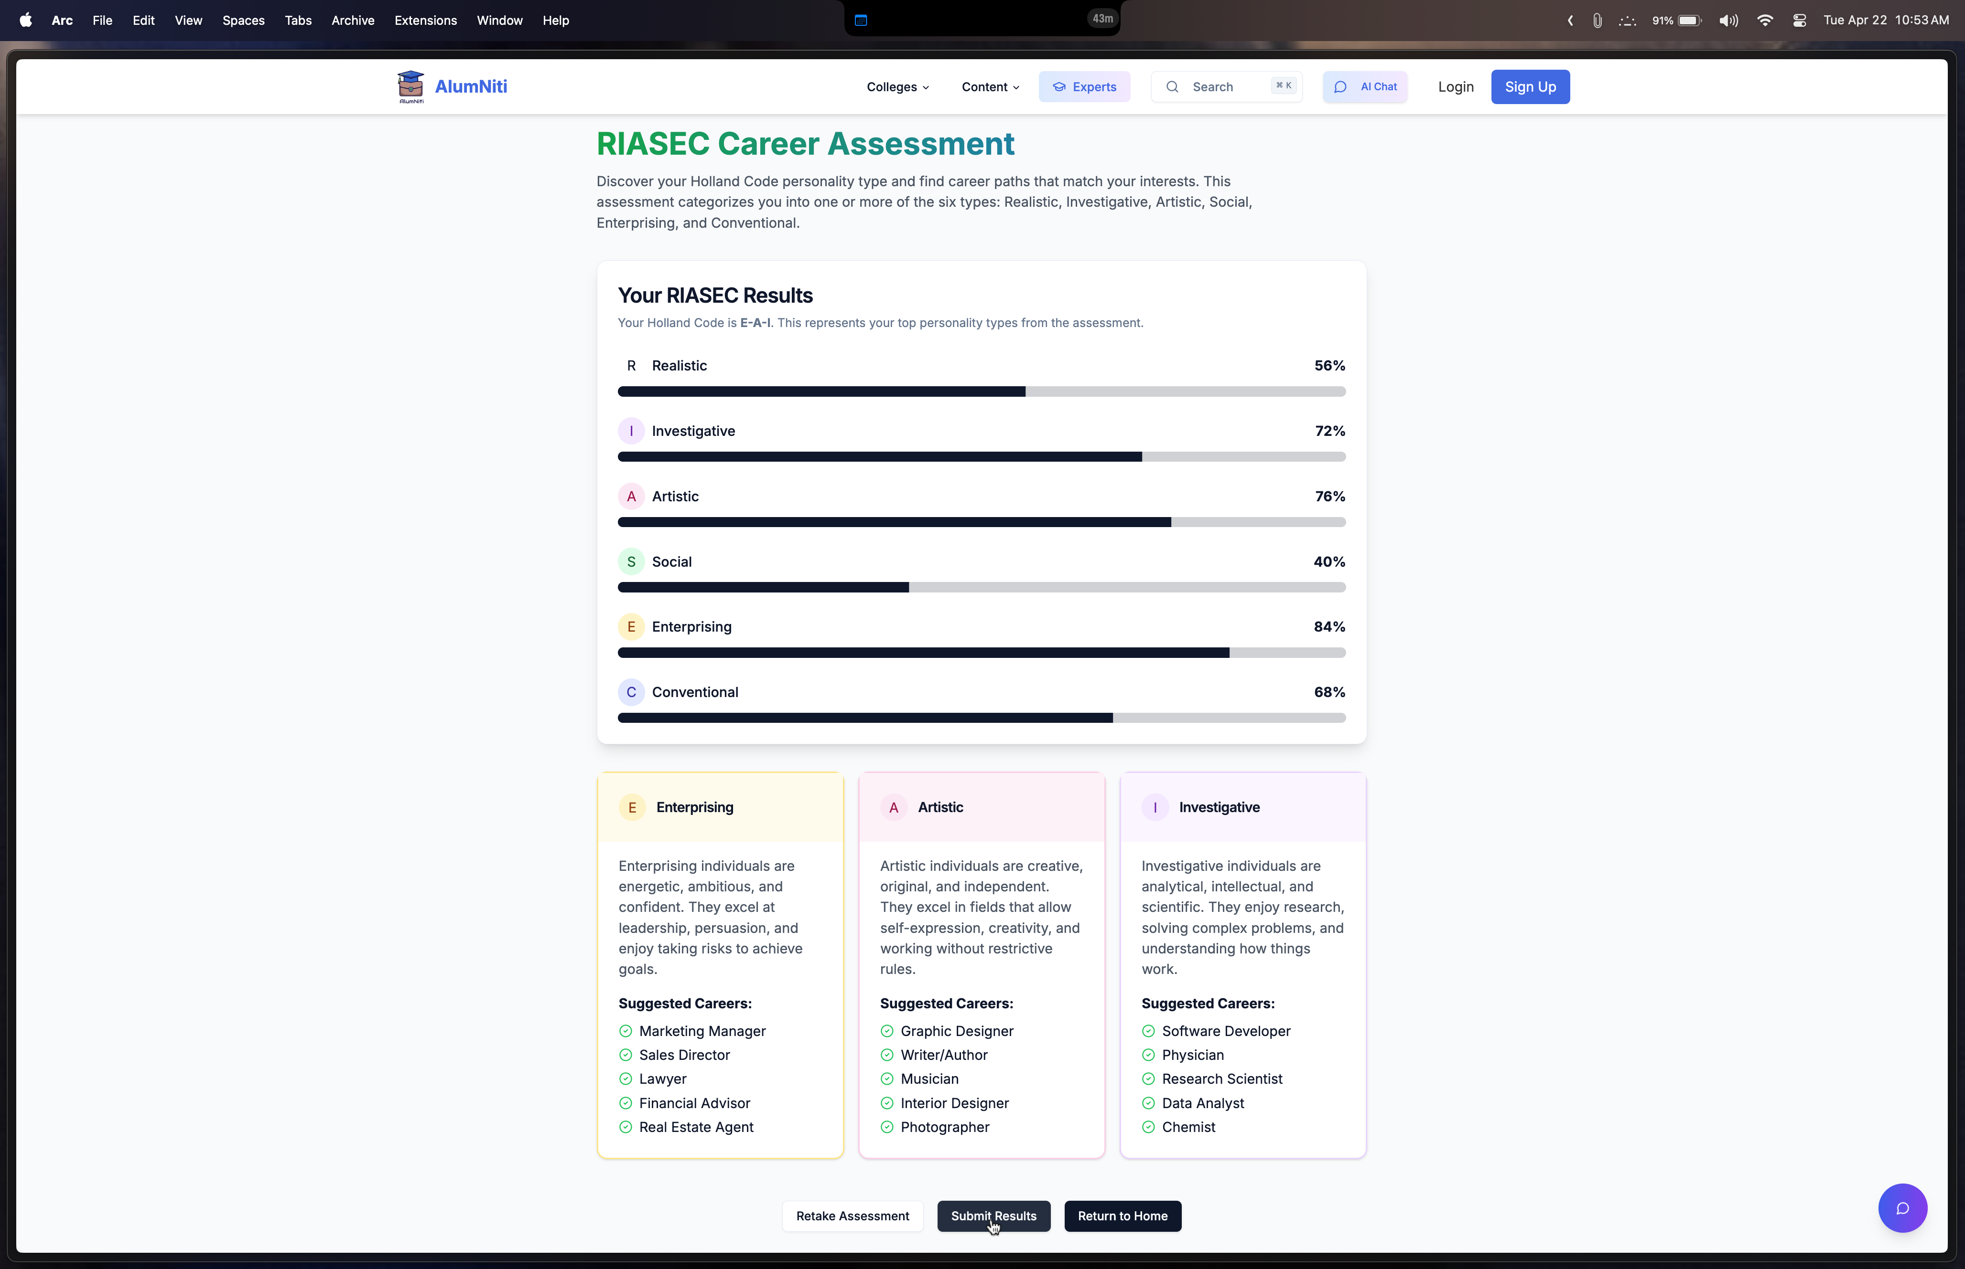
Demo: Results of Psychometric Tests
Notes:
And this is what your results look like after taking our career assessment tests. You can choose to submit it to get further curated guidance.

Slide 13

Section 5 The Horizon

Slide 14




Empowering Journeys: Our Vision & Next Steps
Learn
Guide
Earn
Expand
Learnings: Validated need for trusted data & relevant connections; underscored performance demands.
Broader Vision: AlumNiti as Enabler + Community - Earn, Learn, Guide Others. Aim to Expand Across Domains.
Future Work: Enhanced AI, Secure Cloud Video, Calendly integration, PayPal integration – easy implementation owing to extensive modularity.
Notes:
Our journey reinforced the need for trusted data and relevant connections. Our broader vision is AlumNiti as a community – enabling users to Earn, Learn, and Guide others, eventually expanding across all domains. Possible future work includes enhancing our AI features, securing video content on a dedicated cloud platform, and full payment integration with platforms like PayPal. These integrations are made a breeze with our modular code structure.
DON’T SPEAK: (validation in the sense of of client’s past experiences with people needing such services and people willing to pay for these services)
(broader vision – only difference is how the colleges would be filtered – remaining structure and code remains unchanged,
Designed database to incorporate schools or companies in similar tables as the colleges – database design)
(designed to have discount possibilities for payment depending on college and school and so on)

Slide 15
Let's Make Better Decisions, Together. Choose AlumNiti.
Deployed using Vercel, Render and MongoDB
Your Verified Compass for College & Career Success
R1
College Explorer
Video Insights
R2
AI Chatbot
Expert Dashboard
Connect with alumni
Verified Blogs
Unified search
College-Branch Predictor
Admin Dashboard
Notification Subsystem
Wallet Subsystem
Psychometric Tests
Posts
AI-powered Content Enhancer
Notes:
We are proud to announce that our website is fully functional, using modified Gemini 2.0 Flash for all AI features. We realized early that building the right product isn’t a one-shot thing—it’s iterative. That’s where Agile helped. The whole process demanded flexibility, constant coordination, and not just in tech. Design, usability, user experience, and data handling—all had to sync to make something useful for real people. Choose AlumNiti – your verified compass. Thank you.

Slide 16

Questions?
Client: Aditya Jain Pansari
TA: Muskan Raina
Team: Arihant Tripathy, Jayanth Raju Saraswathi, Mohit Kumar Singh, Prabhav Sai Kollipara, Saksham Chitkara

